Slide 1

Deep Learning System For Discovering Self Driving Intrusions

Slide 2
Supervision : Dr.Mohamed Zedaan Eng.Dina Mohamed

Slide 3

The Team
Antonius Fekry Abdo 20-01015
Yassa Adli Fawzy 20-00562
Youstena Tharwat Gergis 20-00618
Engy Emad Gamil 20-00621
Viola Mamdouh Mounir 20-00063
Alaa Nasser Badr Mahdi 20-00989
Mohamed Mokhtar Saad El-Deen 20-00885

Slide 4
Content Outline
Introduction
Problem Statement
Problem Solution
Related Work
Components of a self-driving car
The CAN Bus
The CAN Bus Security
Software Requirements
Dataset
Test Accuracy screens
Application UI (Phone view)
References

Slide 5
Introduction
With the rapid advancement of self-driving technology, the automotive industry is witnessing a paradigm shift towards autonomous vehicles. As these vehicles become an integral part of our transportation system, ensuring their security against potential intrusions is of paramount importance. Traditional cybersecurity measures may not be sufficient to address the unique challenges posed by self-driving cars. This necessitates the development of innovative and sophisticated intrusion detection systems.
Notes:
Good evening everyone, my name is Beshoy and today I will be presenting our graduation project which is a real estate price prediction application that utilizes artificial intelligence.

Slide 6
Problem Statement
Vulnerabilities in Self-Driving Systems
Risk to Passenger Safety
1
2
3
Challenges in Detection
Identifying the specific weaknesses and potential entry points for intrusions in autonomous vehicle software and hardware.
Analyzing the difficulties in identifying and mitigating intrusions without hindering the functionality of the self-driving system.
Exploring the direct implications and dangers posed by security breaches within self-driving systems.

Slide 7

Problem Solution
Machine Learning Framework
Developing an advanced deep learning model to actively detect and respond to potential intrusions in real-time.
Data-Driven Approach
Automated Response Mechanism
Utilizing large datasets to train the system and improve its accuracy in recognizing diverse intrusion patterns.
Implementing an automatic intervention protocol to mitigate identified intrusions without human intervention.

Slide 8
Related Work
1. Colo Pia Combines Networks and Paths in Arab Vehicles.
2. Intrusion Detection System (IDS) Model for Vehicle Security.
3. High Accuracy and Fast Detection Time in Detecting Network Intrusions in IoV.
4. Protecting Cars from Cyberattacks in the Internet of Vehicles (IoV).
1. Research on Intrusion Detection Models for In-Vehicle Controller Area Network (CAN) Bus Messages.
2. Proposal of a Novel Method Using Attention Mechanism and AutoEncoder for Intrusion Detection.
3. Experimental Results Outperform Traditional Machine Learning Algorithms.
4. Real-Time Prediction Results Achieved in Dual-Core CPU Environment.
5. Shortcomings and Future Research Plans for the AMAEID Model

Slide 9
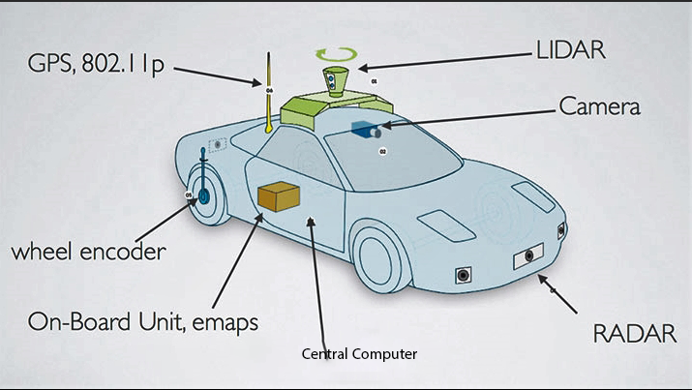
Components of a self-driving car
GPS
LIDER
Camera
Wheel encoder
Central Computer
On-Board Unit, emaps
RADAR

Slide 10
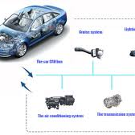
CAN BUS

Slide 11
Topics
Part one : The CAN BUS
Part two : The CAN BUS Security

Slide 12
Part one : The CAN BUS
Introduction
Can Bus Physical Layer
Can Bus Data Link Layer

Slide 13

Introduction to CAN BUS
Controller Area Network Protocol was developed during the late 1980’s by the “Bosch” company.
CAN is half duplex Asynchronous serial communication protocol.
Typically this bus is used for communication between Electronic Control units (microcontrollers) inside a vehicle for example an engine control unit and transmission unit .
• CAN Bus is Robust LOW Cost high speed with high noise immunity and error detection feature protocol .

Slide 14
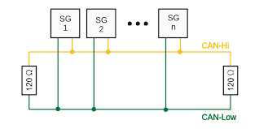
Can Bus Physical Layer
CAN Network Topology :
CAN network is Broadcast type unlike traditional networks such as I2C or USB or Ethernet , massages are sent globally in the network and all the nodes can hear the broadcasted massage without any addressing
Each unit connected to the Bus can transmit or receive a messages over the CAN bus ( Multi Master ) .
Half-duplex : Device’s Can’t send and receive the same time
Asynchronous : The transmitter and reviver do not share a common clock signal

Slide 15
Carrier Sense Multiple Access networks :
For Carrier sense Network each node sense the bus before transmit any data in order to minimize the chance of collision in other words “ nodes Listen before Talk ” and the bus has two
states :
Carrier Busy = Transmission is taking place in the bus
Carrier idle = No transmission currently taking place in bus
The possibility of collision still exists because of propagation delay , a certain node may sense the bus and find that is idle only because the first bit sent by another node has not been received yet

Slide 16

CSMA with Collision detection
CSMA /CD : if two nodes sense the bus to be idle and begin transmitting simultaneously , both of them will detect the collision immediately and they should stop the transmission and wait random period of time and then tries to send data again , this method used by Ethernet LAN networks
CSMA /CD + AMP : Carrier Sense Multiple access with collision detection and arbitration on massage priority
CAN Network is CSMA/CD + AMP
When two or more nodes begin sending messages at same time collision is detected and the message with the highest priority will overwrite other messages using bit wise arbitration , It means that only this highest priority message remains on the bus

Slide 17
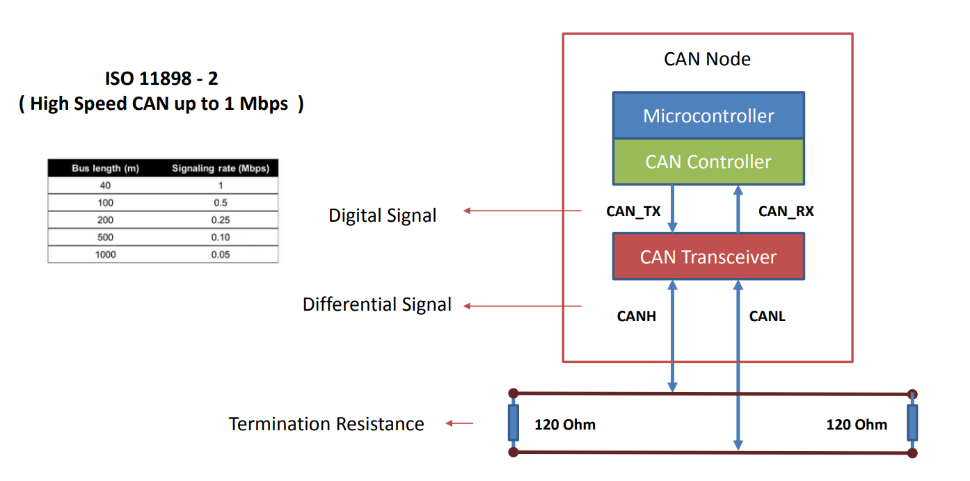
CAN Network Physical Connections

Slide 18
Can Bus Data Link Layer
CAN Massage Type
Date frame :The data frame is the most common message it is the only frame for actual data transmission
Remote frame :Generally data transmission is performed on an autonomous basis with the data source node (e.g., a sensor) sending out a Data Frame. It is also possible, however, for a destination node to request the data from the source by sending a Remote Frame.
Error frame : The error frame is a special message It is transmitted when a node detects an error in a message, The original transmitter then automatically retransmits the message.
Over load frame : The overload frame is mentioned for completeness. It is similar to the error frame with regard to the format, and it is transmitted by a node that becomes too busy. It is primarily used to provide for an extra delay between messages.

Slide 19
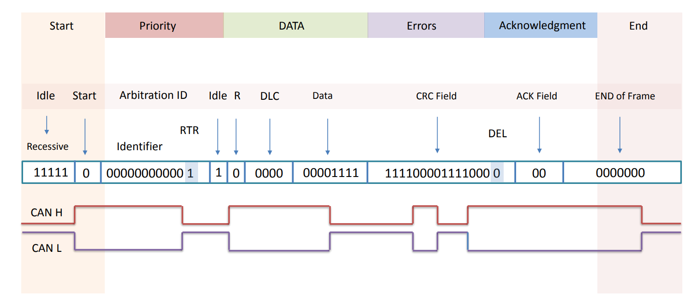
CAN Massage Format

Slide 20
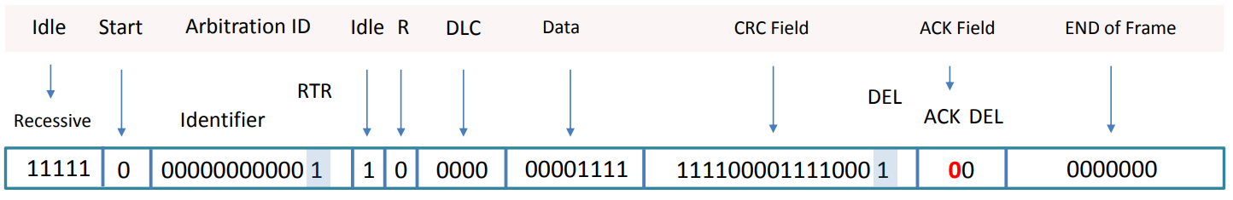
SOF : The single dominant start of frame (SOF) bit marks the start of a message, and is used to synchronize the nodes on a bus after being idle.
Identifier - The Standard CAN 11-bitidentifier establishes the priority of the message. The lower the binary value, the higher its priority.
RTR : Remote transmission request (RTR) bit is dominant when information is required from another node. All nodes receive the request, but the identifier determines the specified node. The responding data is also received by all nodes and used by any node interested.
R : Reserved bit (for possible use by future standard amendment)
DLC : The 4-bit data length code (DLC) contains the number of bytes of data being transmitted , Data–Up to 64 bits of application data may be transmitted.
CRC : Cyclic Redundancy Check ( Code generated by the transmitter helps for error detection ).
CRC DEL :CLC Delimiter must be recessive .
ACK : Transmitter sends recessive and any receiver can assert a dominant .

Slide 21
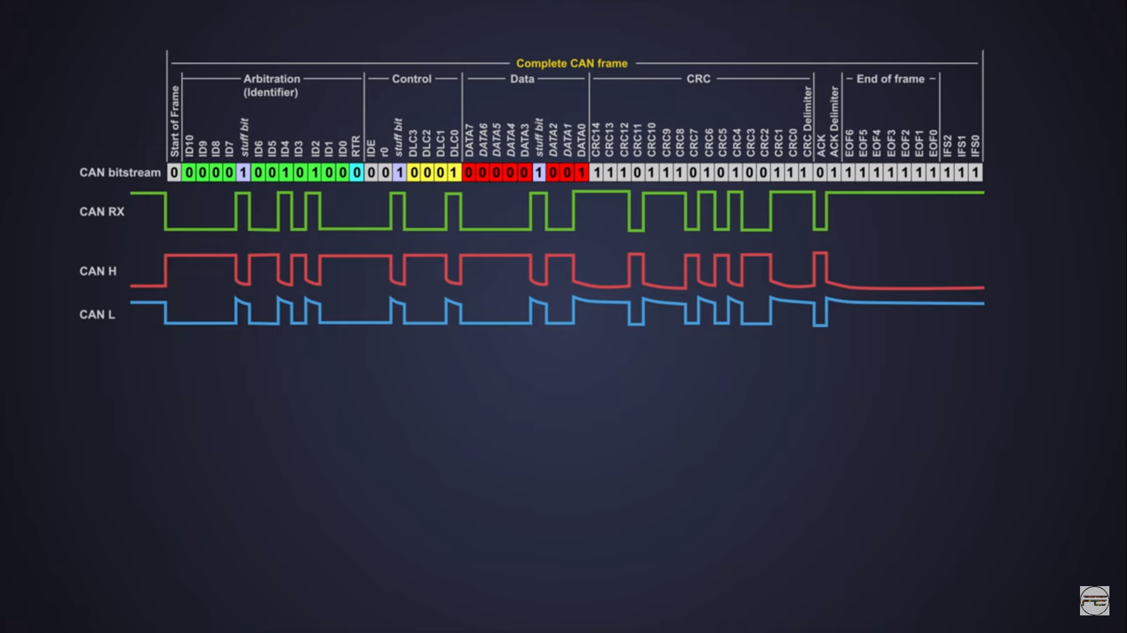

Slide 22
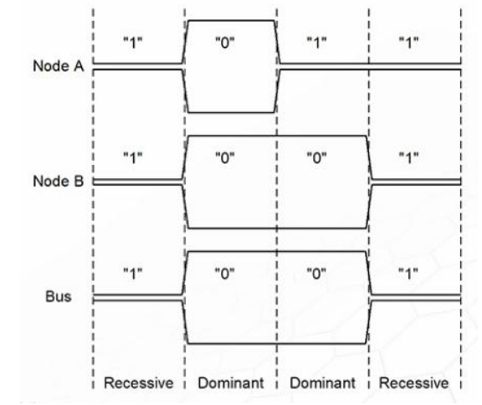
BUS Bitwise Arbitration
Lets Assume that Two nodes try to access the can bus at the same time .
Node A sends 1011
Node B sends 1001

Slide 23
Types of Attacks
When an attacker gains access to the Controller Area Network (CAN) bus, there are various types of attacks they can perform to compromise the integrity, confidentiality, or availability of the communication on the bus. Here are three broad types of CAN bus attacks:
Message Manipulation or Injection:
Spoofing: The attacker sends messages on the CAN bus pretending to be a legitimate node. This can involve sending falsified sensor data or injecting malicious commands into the network.
Replay Attacks: The attacker records and then retransmits legitimate messages to manipulate the system's behavior. This can be used to repeat certain actions or confuse the system.
Denial-of-Service (DoS) Attacks:
Flooding: The attacker floods the CAN bus with a high volume of messages, overwhelming the network and causing legitimate messages to be delayed or lost.
Bus-off Attacks: By repeatedly transmitting faulty or malformed messages, an attacker can force certain nodes on the CAN bus to go into a "bus-off" state, rendering them temporarily or permanently inoperable.

Slide 24
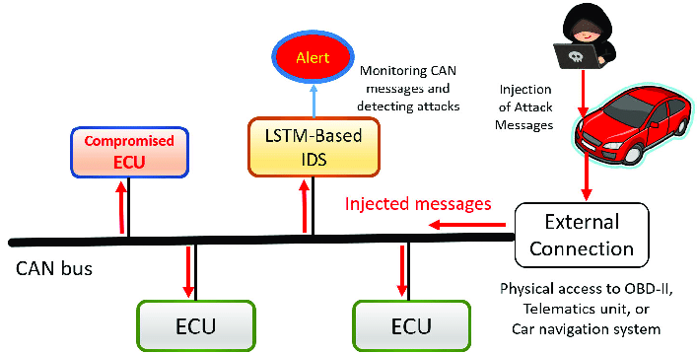
Physical Layer Attacks:
Electromagnetic Interference (EMI): Manipulating the physical environment to introduce electromagnetic interference that disrupts the CAN bus communication. This interference can lead to corruption or loss of messages.
Voltage Attacks: Introducing abnormal voltage levels on the bus to disturb or damage connected electronic components. This can be achieved by manipulating power supplies or inducing voltage spikes.
It's important to note that these attacks can have serious consequences, particularly in automotive and industrial contexts where CAN bus is widely used. As a result, securing the CAN bus against unauthorized access and implementing measures to detect and mitigate potential attacks is crucial for maintaining the overall security and reliability of systems relying on this communication protocol.

Slide 25
Attacks on CAN Bus :
Certainly, let's delve into explanations for each of the mentioned attacks on the Controller Area Network (CAN) bus:
Bus Flood Attack:
Description: In a Bus Flood Attack, the attacker floods the CAN bus with a high volume of messages, overwhelming the network.
Objective: The primary goal is to disrupt normal communication on the CAN bus by consuming the available bandwidth, causing legitimate messages to be delayed or lost.
Impact: This can lead to performance degradation and potential malfunctions in systems that rely on timely and accurate communication.
Simple Frame Spoofing:
Description: In Simple Frame Spoofing, the attacker sends unauthorized messages onto the CAN bus by mimicking the format of legitimate messages.
Objective: The goal is to inject false information or commands into the network, potentially causing the receiving nodes to act on the malicious data.
Impact: This type of attack can lead to incorrect system behavior, as nodes may respond to or act upon falsified information.

Slide 26
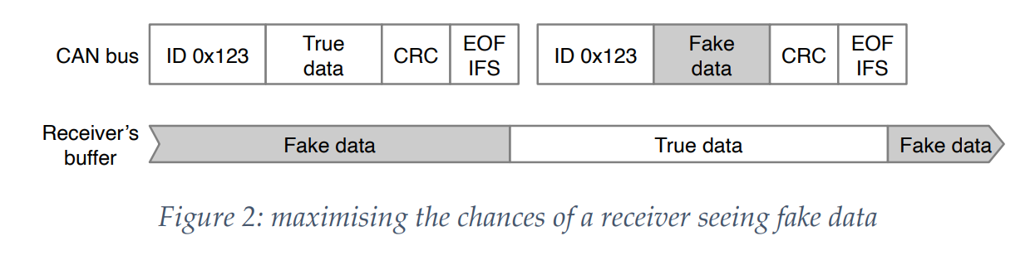
Adaptive Spoofing:
Description: Adaptive Spoofing is a more sophisticated form of frame spoofing where the attacker dynamically adjusts their attack strategy based on the responses and behavior of the targeted system.
Objective: The attacker adapts their spoofed messages to evade detection and more effectively manipulate the system over time.
Impact: Adaptive Spoofing can be challenging to detect because the attacker modifies their tactics, making it harder for security measures to identify and prevent the malicious activity.

Slide 27
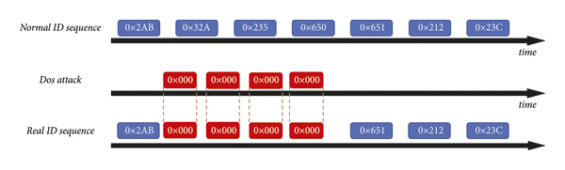
(1) DoS Attack. All ECU nodes share the same bus resources, and no node is under the administrator’s control. In this case, a malicious ECU can increase the bus occupancy without following the bus protocol, causing delays, or even suspending other messages. Therefore, hackers can implement DoS attacks by injecting high-priority messages into the bus in a short time, thus preventing the delivery of other CAN messages. An example of the DoS attack is depicted in Figure 3. The bus messages with higher priority (e.g., ID = 0x000) were randomly injected into the typical message traces at high speed. For example, a DoS attack can be implemented by injecting packets with an ID of 0x000 at a rate that is ten times the regular message interval

Slide 28
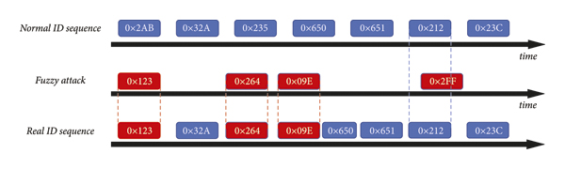
(2) Fuzzy Attack. A fuzzy attack indicates that an attacker sends random compromised IDs and data to the CAN network at any time, even if the attacker does not have any specific information about the victim. The attacker is only required to send a malicious message in the same form as a normal CAN message all the time, and the vehicle may be successfully attacked. Unlike a DoS attack, the fuzzy attack paralyzes the vehicle’s functionality or causes an abnormal ECU reaction instead of preventing regular message delivery by occupying the bus. Therefore, fuzzing attack messages consisting of random IDs and data are randomly inserted into the regular CAN bus traffic. An example of the attack is shown in Figure 4. When the fuzz attack was implemented on the test vehicle, the vehicle randomly performed abnormal reactions, such as abnormal engine noise, flashing lights, abnormal increase in power, and gear switching

Slide 29




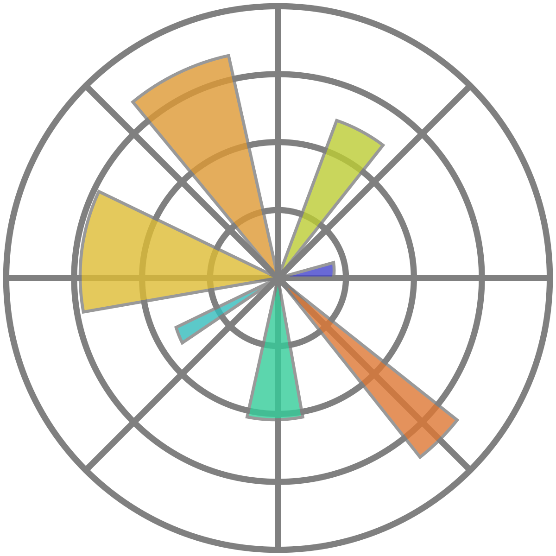




Software Requirements
Python
Tensor Flow
Numpy
Pandas
Matplotlib
Sklearn
Figma
Firebase
Flutter
Flask

Slide 30
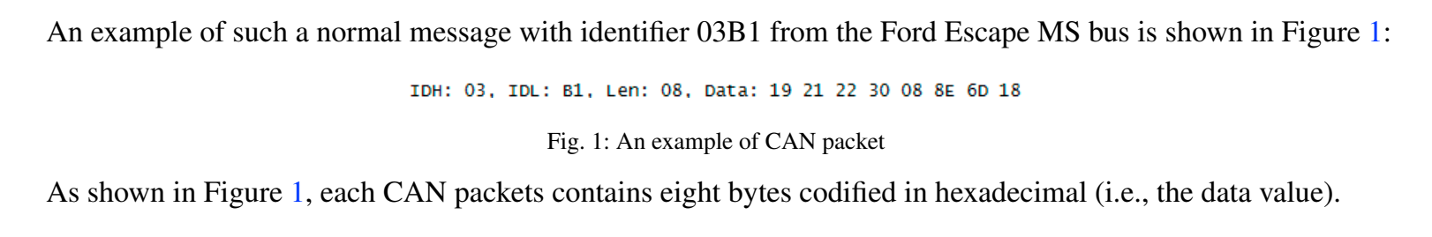
The CAN packets are contained in a message: each message is composed by following values:
• Timestamp : recorded time (s);
• CAN ID : identifier of CAN message in HEX (i.e., 03B1);
• DLC : number of data bytes, from 0 to 8;
• DATA[0 7] : data value (byte)

Slide 31
We extracted the feature vector from four dataset freely available for research purposes2 including normal realworld CAN messages and four different kinds of injected messages caused by following attacks: dos attack (dos), fuzzy attack (fuzzy), spoofing the drive gear (gear) and spoofing the RPM gauge (rpm) [21]. Dataset were constructed by logging CAN traffic through the OBD-II (On-Board Diagnostics) port from a real vehicle while message injection attacks were performing. Dataset contain each 300 intrusions of message injection. Each intrusion performed for 3 to 5 seconds, and each dataset has total 30 to 40 minutes of CAN traffic. We describe in details the four type of attacks:
• dos : it represent the denial of service attack, performed by injecting messages of ‘0000’ CAN ID every 0.3 milliseconds. The ‘0000’ CAN ID is the most dominant;
• fuzzy: injecting messages of totally random CAN ID and DATA values every 0.5 milliseconds;
• gear/rpm : injecting messages of certain CAN ID related to gear/rpm information every 1 millisecond. The rpm (i.e., revolutions per minute) measures the number of revolutions completed in one minute around a fixed axis. Running an engine at a high RPM may cause damage to the engine and reduce its expected lifespan.

Slide 32
Dataset and models
Dataset’s name: Car-Hacking Dataset for the intrusion detection
Types of attacks inside the dataset:-
DoS Attack
Fuzzy Attack
Spoofing the drive gear
Spoofing the RPM gauze

Slide 33
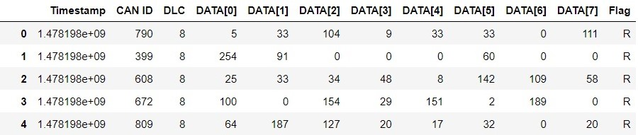
Dataset
DATA ATTRIBUTES:-
Timestamp
CAN ID
DLC
DAT[0~7]
Flag

Slide 34
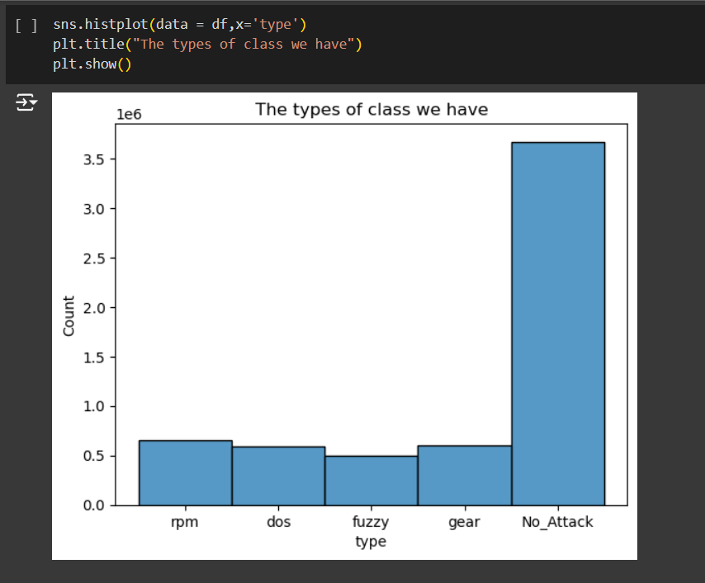
The merge dataset visualization

Slide 35
1. Convolutional Neural Network (CNN)
Overview:
Purpose: Best suited for image data or spatial data.
Architecture: Composed of convolutional layers, pooling layers, and fully connected layers.
Visualization:
Training Accuracy and Loss: Plot the accuracy and loss over epochs.
Feature Maps: Visualize intermediate feature maps from convolutional layers

Slide 36
1.1 Dos dataset
1.2 Fuzzy dataset
1.3 Gear dataset

Slide 37
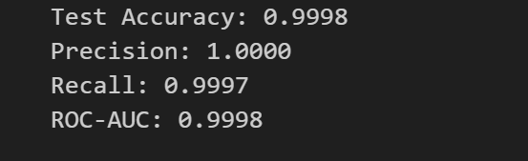
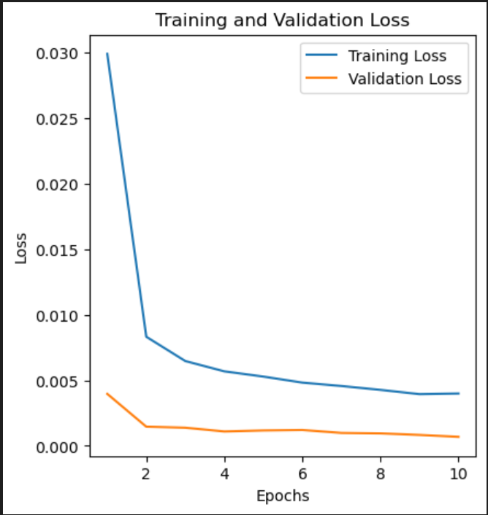
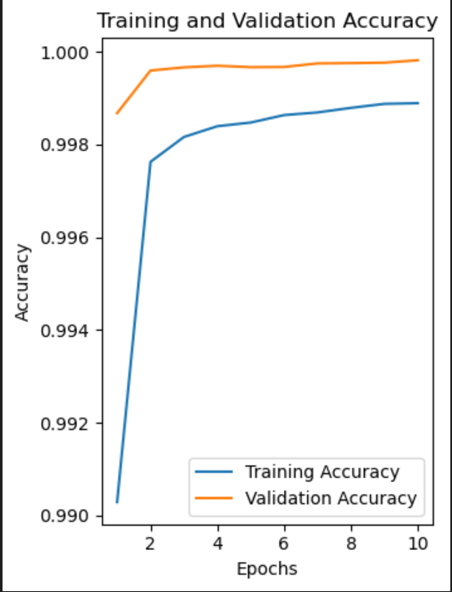
1.4 RPM dataset
1.5 Merge dataset

Slide 38
2. Long Short-Term Memory (LSTM)
Overview:
Purpose: Ideal for sequence data and time series.
Architecture: Uses LSTM layers to capture long-term dependencies.
Visualization:
Training Loss: Plot the loss over epochs.
Predictions vs Actuals: Compare the model's predictions to actual values.

Slide 39
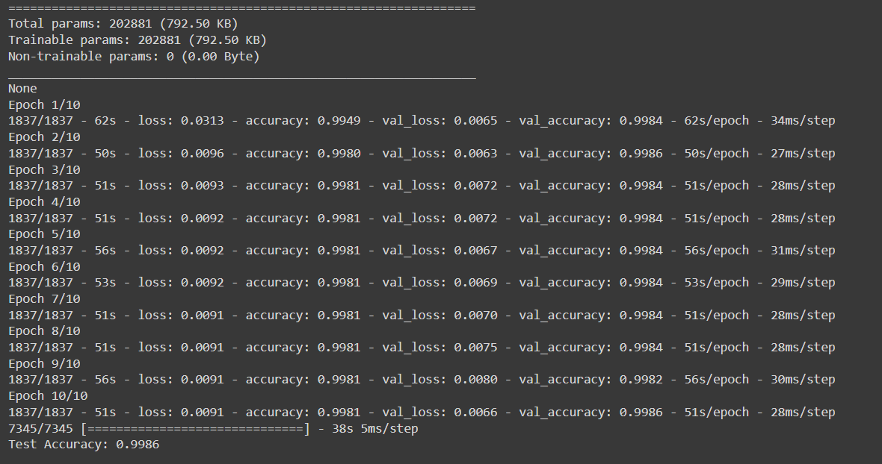
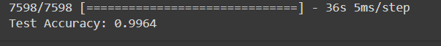
2.1 Dos dataset
2.2 RPM dataset

Slide 40
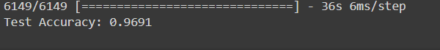
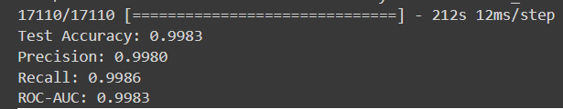
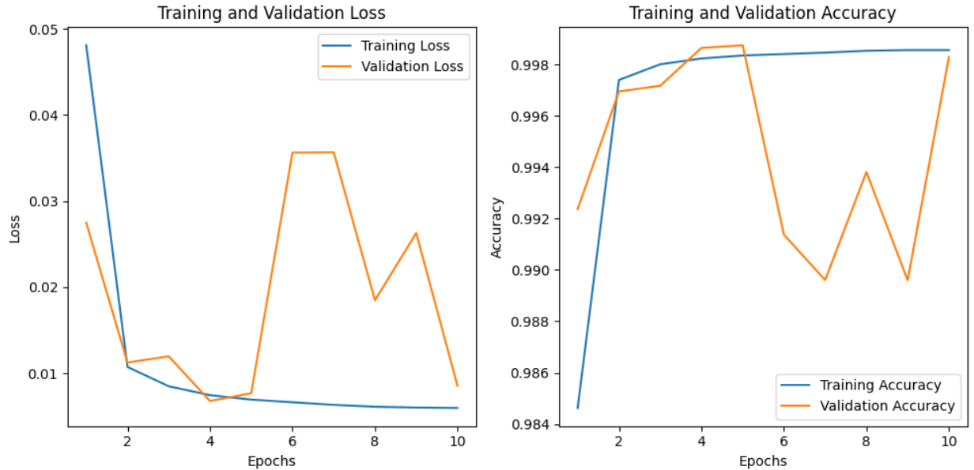
2.3 Fuzzy dataset
2.3 Gear dataset
2.5 Merge dataset

Slide 41
3. Bidirectional Recurrent Neural Network (BRNN) Model
Overview
Purpose:
The BRNN model leverages bidirectional recurrent neural networks to capture temporal dependencies in structured data. This ensures information from both past and future contexts is considered, improving performance on sequential or time-series data.
Architecture:
The architecture combines input data with BRNN layers, processing data in both forward and backward directions for a comprehensive understanding.
Visualization
Hidden State Attention Maps:
Visualize the attention of the BRNN at each time step, highlighting the importance of each element in the sequence.
Training Metrics:
Display training and validation accuracy and loss over epochs to monitor performance and convergence.

Slide 42
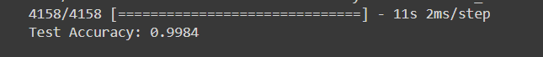
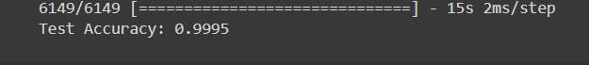
3.1 Dos dataset
3.2 RPM dataset
3.3 Fuzzy dataset

Slide 43
3.4 Gear dataset
3.5 Merge dataset

Slide 44
Application
First Step
Design GUI Figma
Second Step
Create mobile application using flutter
Third Step
Create Backend Server using Flask API
Connect the mobile application with Deep learning using Flask API
Fourth Step

Slide 45
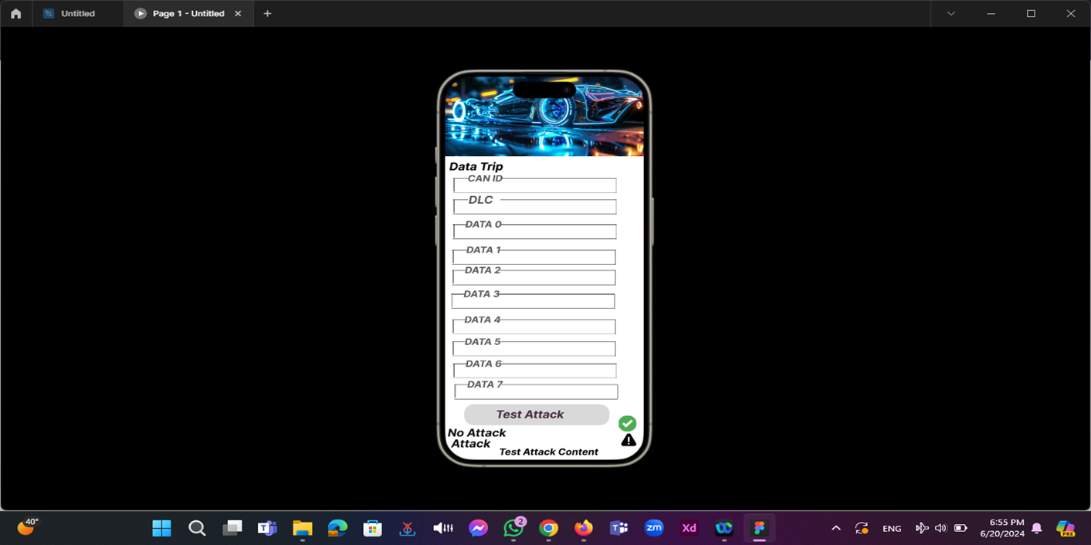
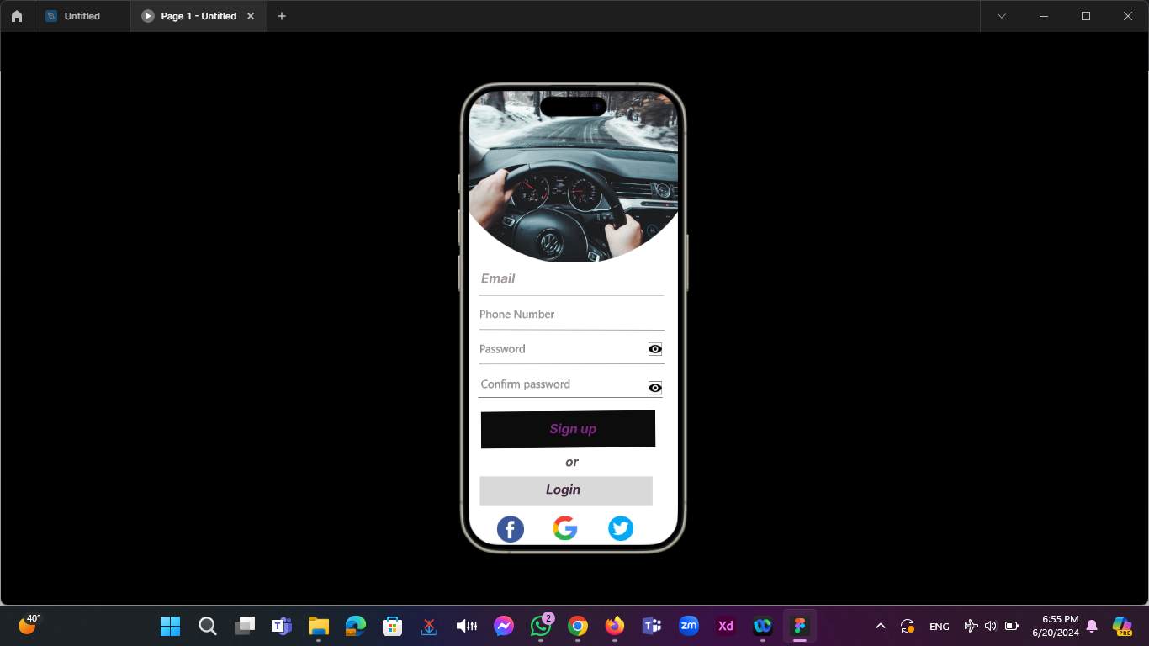
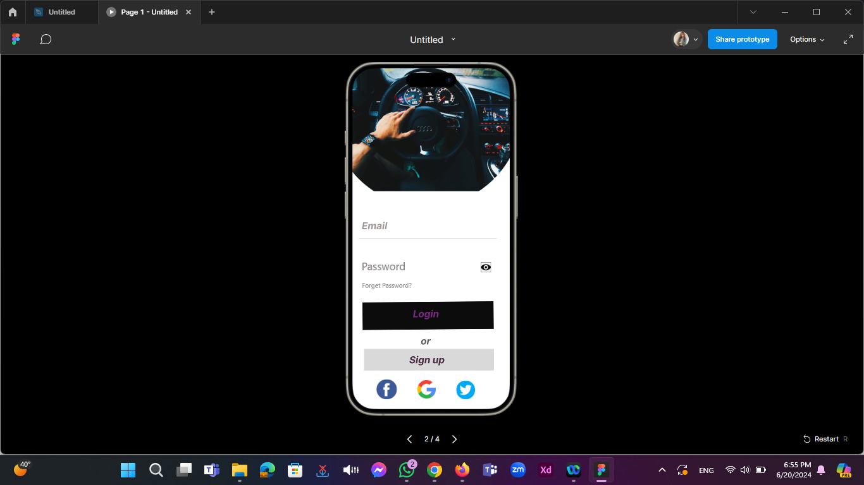
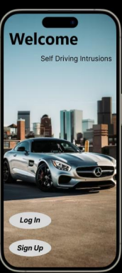
Application UI (Phone view)
Pages :
Home Page , Log In or Sign Up , Data Trip

Slide 46

References
Industrial & Automotive Buses CAN Bus : ENG. HASSAN Al-IRAQE
Attacks on the CAN Bus and their mitigations, Dr. Ken Tindell, CTO Canis Automotive Labs
Hindawi Journal of Advanced Transportation Volume 2020, Article ID 3035741, 9 pages https://doi.org/10.1155/2020/3035741
Youtube channals
Chat GPT
Mehmet Bozdal, Mohammad Samie, Ian Jennions IVHM Centre, Cranfield University, Bedford, MK43 0AL, UK
Figure page 40 :- https://onlinelibrary.wiley.com/doi/10.1111/exsy.12754
Figure page 41 :- https://www.mdpi.com/1424-8220/19/24/5370
Figure page 44 :- https://www.mdpi.com/1424-8220/21/12/3993

Slide 47

Thank you

